Slide 1
Spider Glove: Assemble and Program a Robotic Glove
Rehabilitation Robotics Laboratory

Slide 2
What is Disability?
In General
Notes:
Hold an interactive question & answer session about what the children think disability is.
During the conversation, ask if they know the three categories of disability.

Slide 3
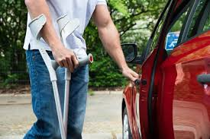
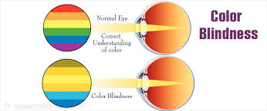
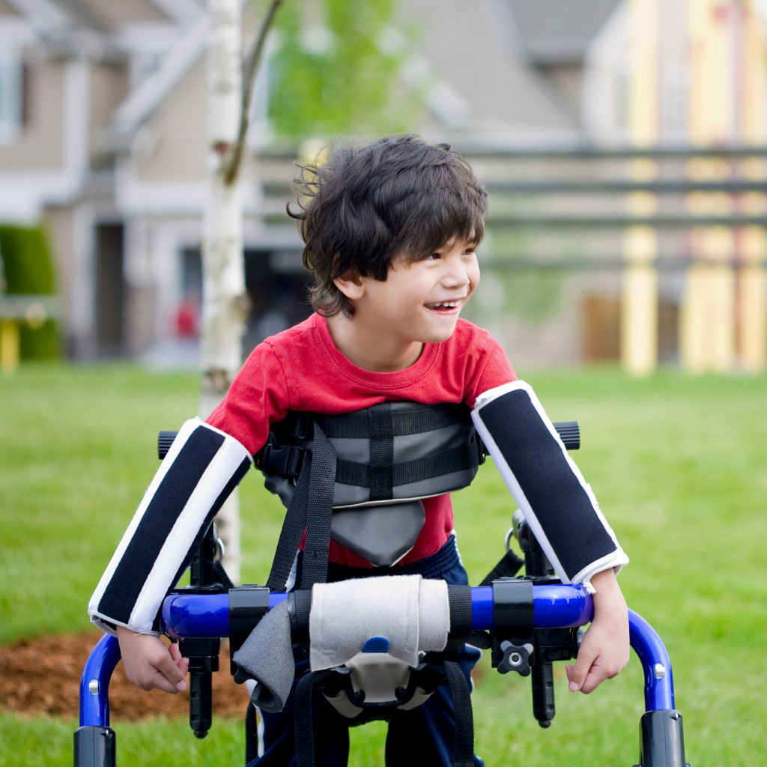
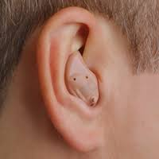
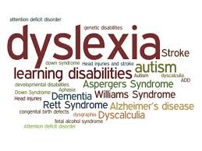
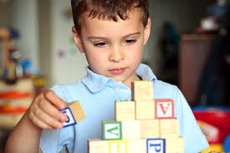
What is Disability?
Physical
Sensory
Cognitive
Notes:
Show some examples of what it looks like when someone is color blind, the colors of what it actually looks like.
Developmental (when someone hasn’t developed physically, cognitively ot sensory wise)
Acute is a short-term disability or impairment.
Physical- motion limitations
Top break leg
Cerebral palsy inherent
Concussion
Dyslexia
Down syndrome
Sensory - color blindness
Burn temporary disability

Slide 4
Physical
limitation on a person's physical functioning, mobility, dexterity or stamina
Inherent: Cerebral palsy
Acquired: Broken bone

Slide 5
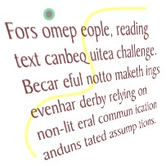
Cognitive
greater difficulty with one or more types of mental tasks than the average person
Memory
Problem-solving
Attention
Reading, linguistics, and comprehension
Math comprehension
Inherent: Down syndrome
Acquired: Concussion
Notes:
Other sensory and won’t touch but more on handout

Slide 6
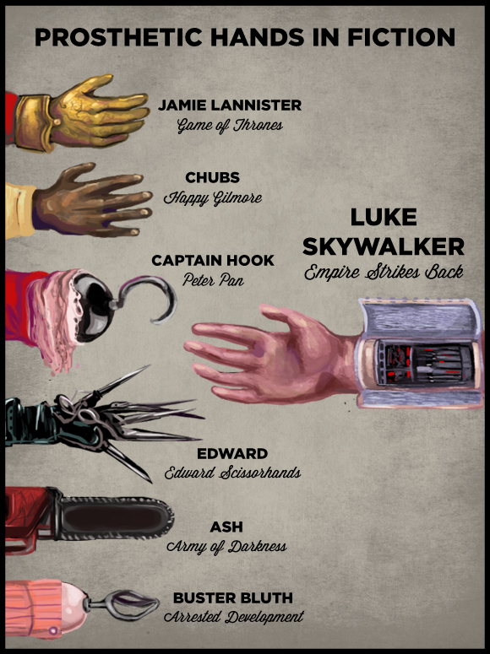
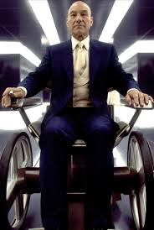
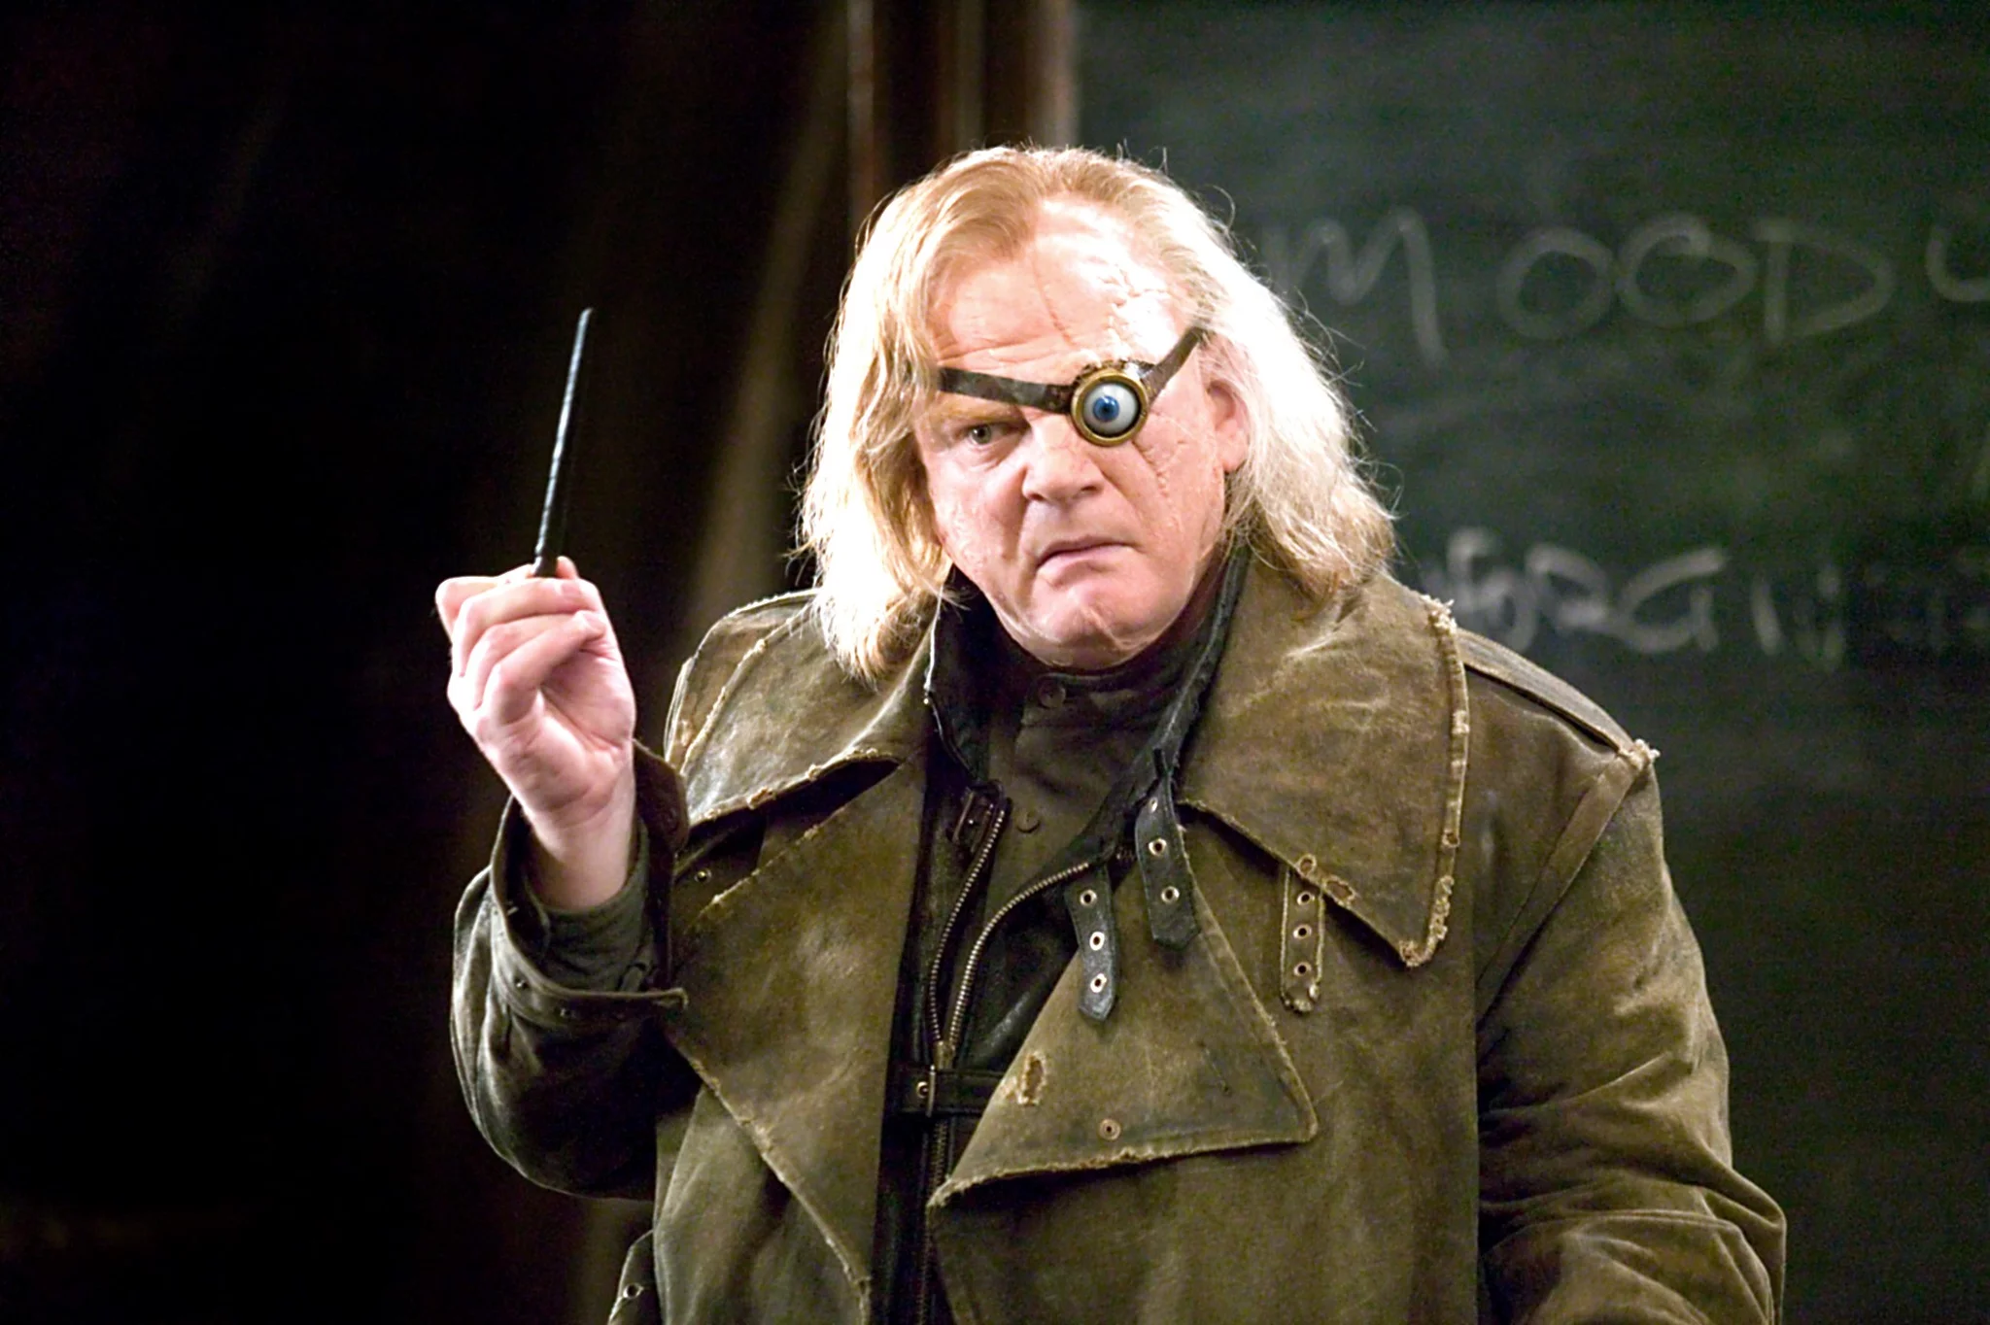
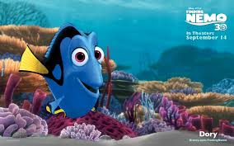
Disability in Pop Culture
Notes:
Make sure to discuss how people don’t like to be wheelchair bound, maybe discuss terms and how to refer to disability. The emotional and psychological trauma that comes with disability as well.
The purpose of the slide is to destigmatize disability by showing that it is present everywhere, in people that you know, such as friends or grandparents, as well as in media that you see everyday.
Students may not notice that people with disability are present in everyday film and media.

Slide 7
2. Stroke
As a cause of disability
Notes:
Have you heard about stroke?
Explain how stroke can be a disability
We’ll go over why stroke happens + disability
Interactive Q

Slide 8
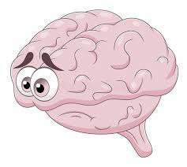
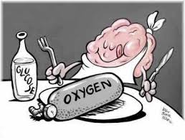
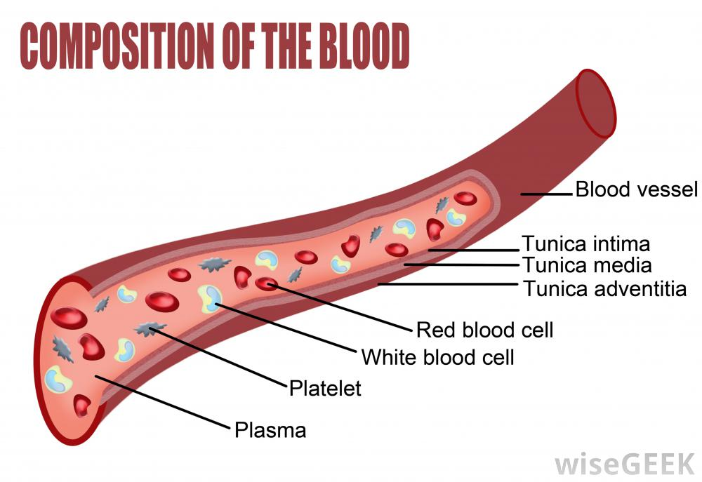
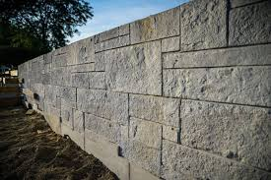
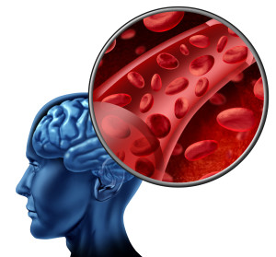
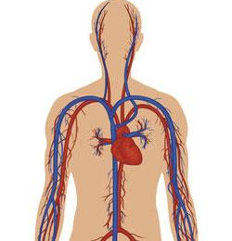
What causes a stroke?
Clot or rupture
Notes:
Maybe reference less technical in terms of anatomy, but this would depend on their age.
Explain how you can get that block, and how plaque builds.
Question and Answer discussion:
Provide a cardiovascular system overview and how the brain needs oxygen and glucose.
Glucose is constant as we eat.
Oxygen is only from blood and only from breathing.
How do you think oxygen would be cut off from brain cells if respiratory system is functional?

Slide 9
Warning Signs and Symptoms
FAST
Face: Smile and see if one side of the face droops.
Arms: Raise both arms. Does one arm drop down?
Speech: Say a short phrase and check for slurred or strange speech.
Time: If any of these symptoms appear, the person most likely is experiencing a stroke and it is time to call 911.

Slide 10
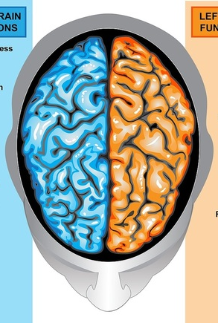
How Does a Stroke Affect Your Brain?
Right
Left-side body control
Art and Music
Creativity
Left
Right-side body control
Math and Science
Analytical

Slide 11
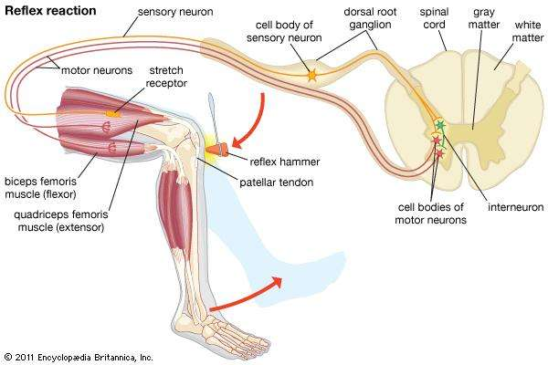
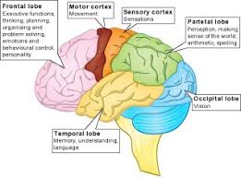
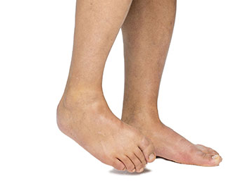
How a Stroke Affects Muscles
Spasticity = stiffness in muscles and limited mobility

Slide 12
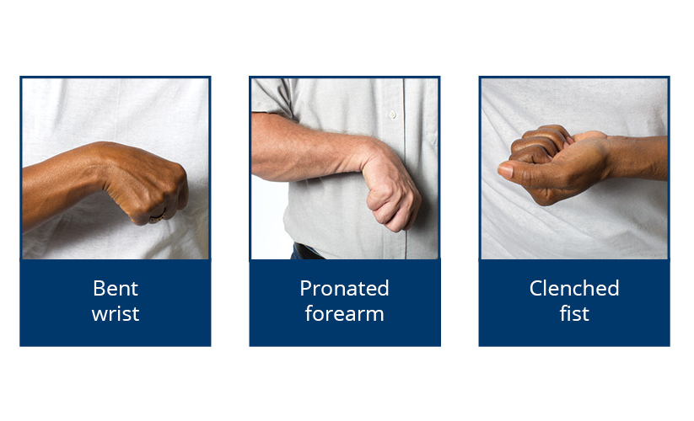
Notes:
Discuss about the muscles and why certain exercises are good or not.

Slide 13
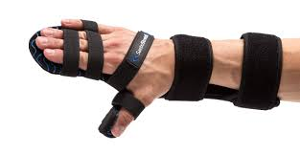
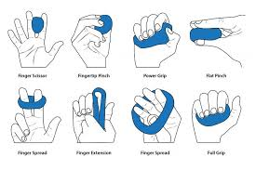

Slide 14
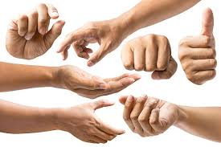
Grasp activity!
Notes:
Demonstrate which muscles are working when you squeeze different things.
Show a video of an exercise that students can follow.

Slide 15
3. Rehabilitation and Robotics
Notes:
Do you know of any systems for robotics in rehabilitation?

Slide 16
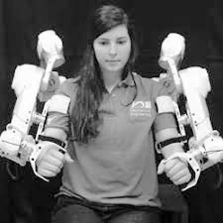
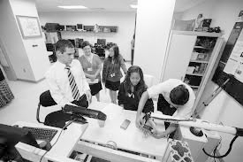
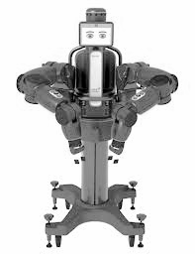
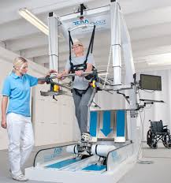
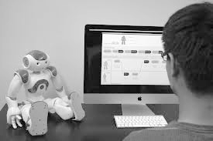
Notes:
Commercial

Slide 17
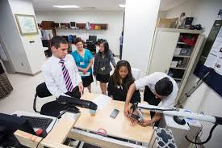
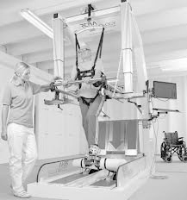
Notes:
Research

Slide 18
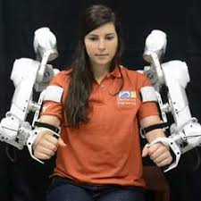
Notes:
Research about that

Slide 19
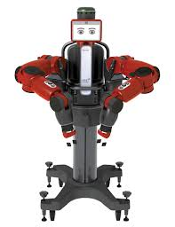
Notes:
Nao and Baxter commercial, used for research

Slide 20
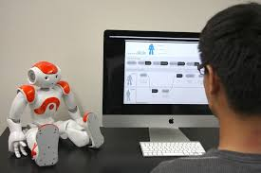
Notes:
Nao and Baxter commercial, used for research

Slide 21
4. Circuit Basics
Notes:
What do you know about circuits?

Slide 22
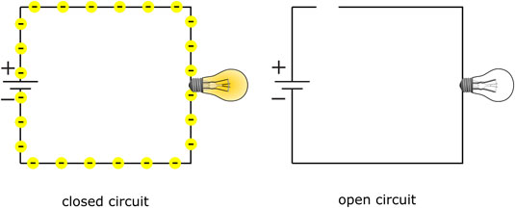
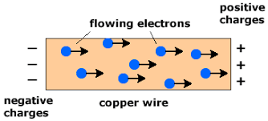
The Basics of Circuitry
Notes:
Questions: about electrons?
Focus on the opposites attract, maybe with magnets.
Show parallel and series circuits as well, or a circuit from the glove.
Explanation and use for discussion:
https://science.howstuffworks.com/environmental/energy/circuit1.htm
Use a video or more intuitive diagram for this slide.

Slide 23
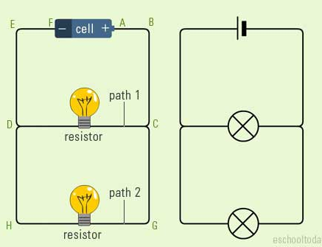
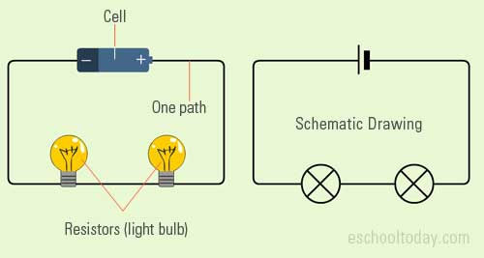
Two Circuits
Notes:
Written down in document format + instructions of activities
Q: circuits? Asking
Incentive

Slide 24
5. Gamification
Notes:
Asking about what they know about gamification and what are some examples they see everyday.
Ask questions for gamification as well, such as why they find certain games or applications fun.
Why it’s important for motivation and greater impact in rehabilitation.
enAble games are an example to demonstrate.

Slide 25
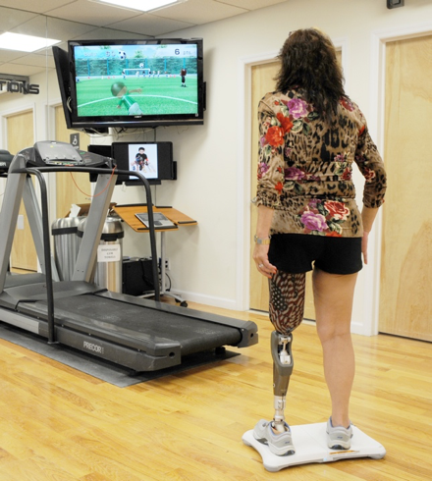
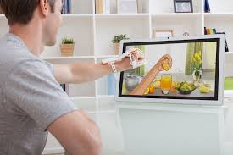
Notes:
Q: Like to go to doctor?
To try to motivate, researchers have made fun games
Robots, circuits, fun games, etc

Slide 26
Notes:
Q: Like to go to doctor?
To try to motivate, researchers have made fun games
Robots, circuits, fun games, etc

Slide 27
Notes:
Q: Like to go to doctor?
To try to motivate, researchers have made fun games
Robots, circuits, fun games, etc

Slide 28
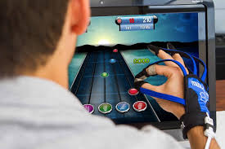
Notes:
Everything put together
Imagine hand spasticity - putty exercises can be boring and repetitive
Game through circuitry
This is what we will be building and programming today!
Robot glove: current model is loose around the fingers.
Provide name for the robot glove as well.

Slide 29
Glove Assembly
Assembly and Testing

Slide 30
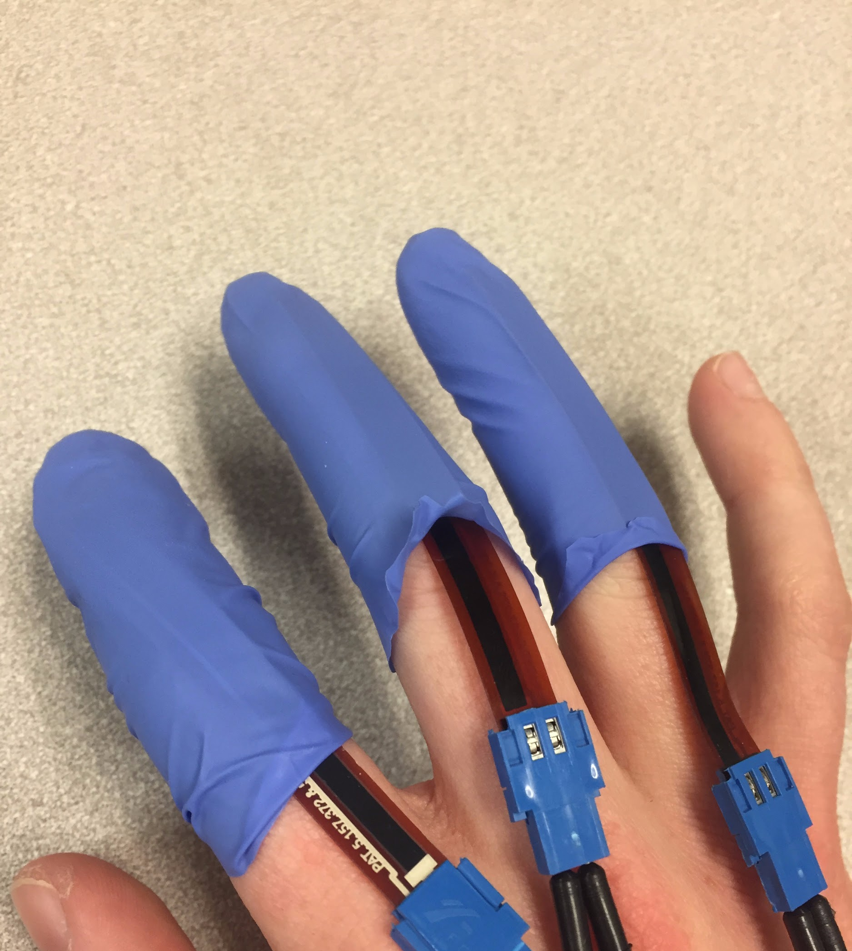
Finger Assembly
Notes:
Include speaker notes
Workshop plan - step by step instructions
Cut fingers off the glove etc
Steps

Slide 31
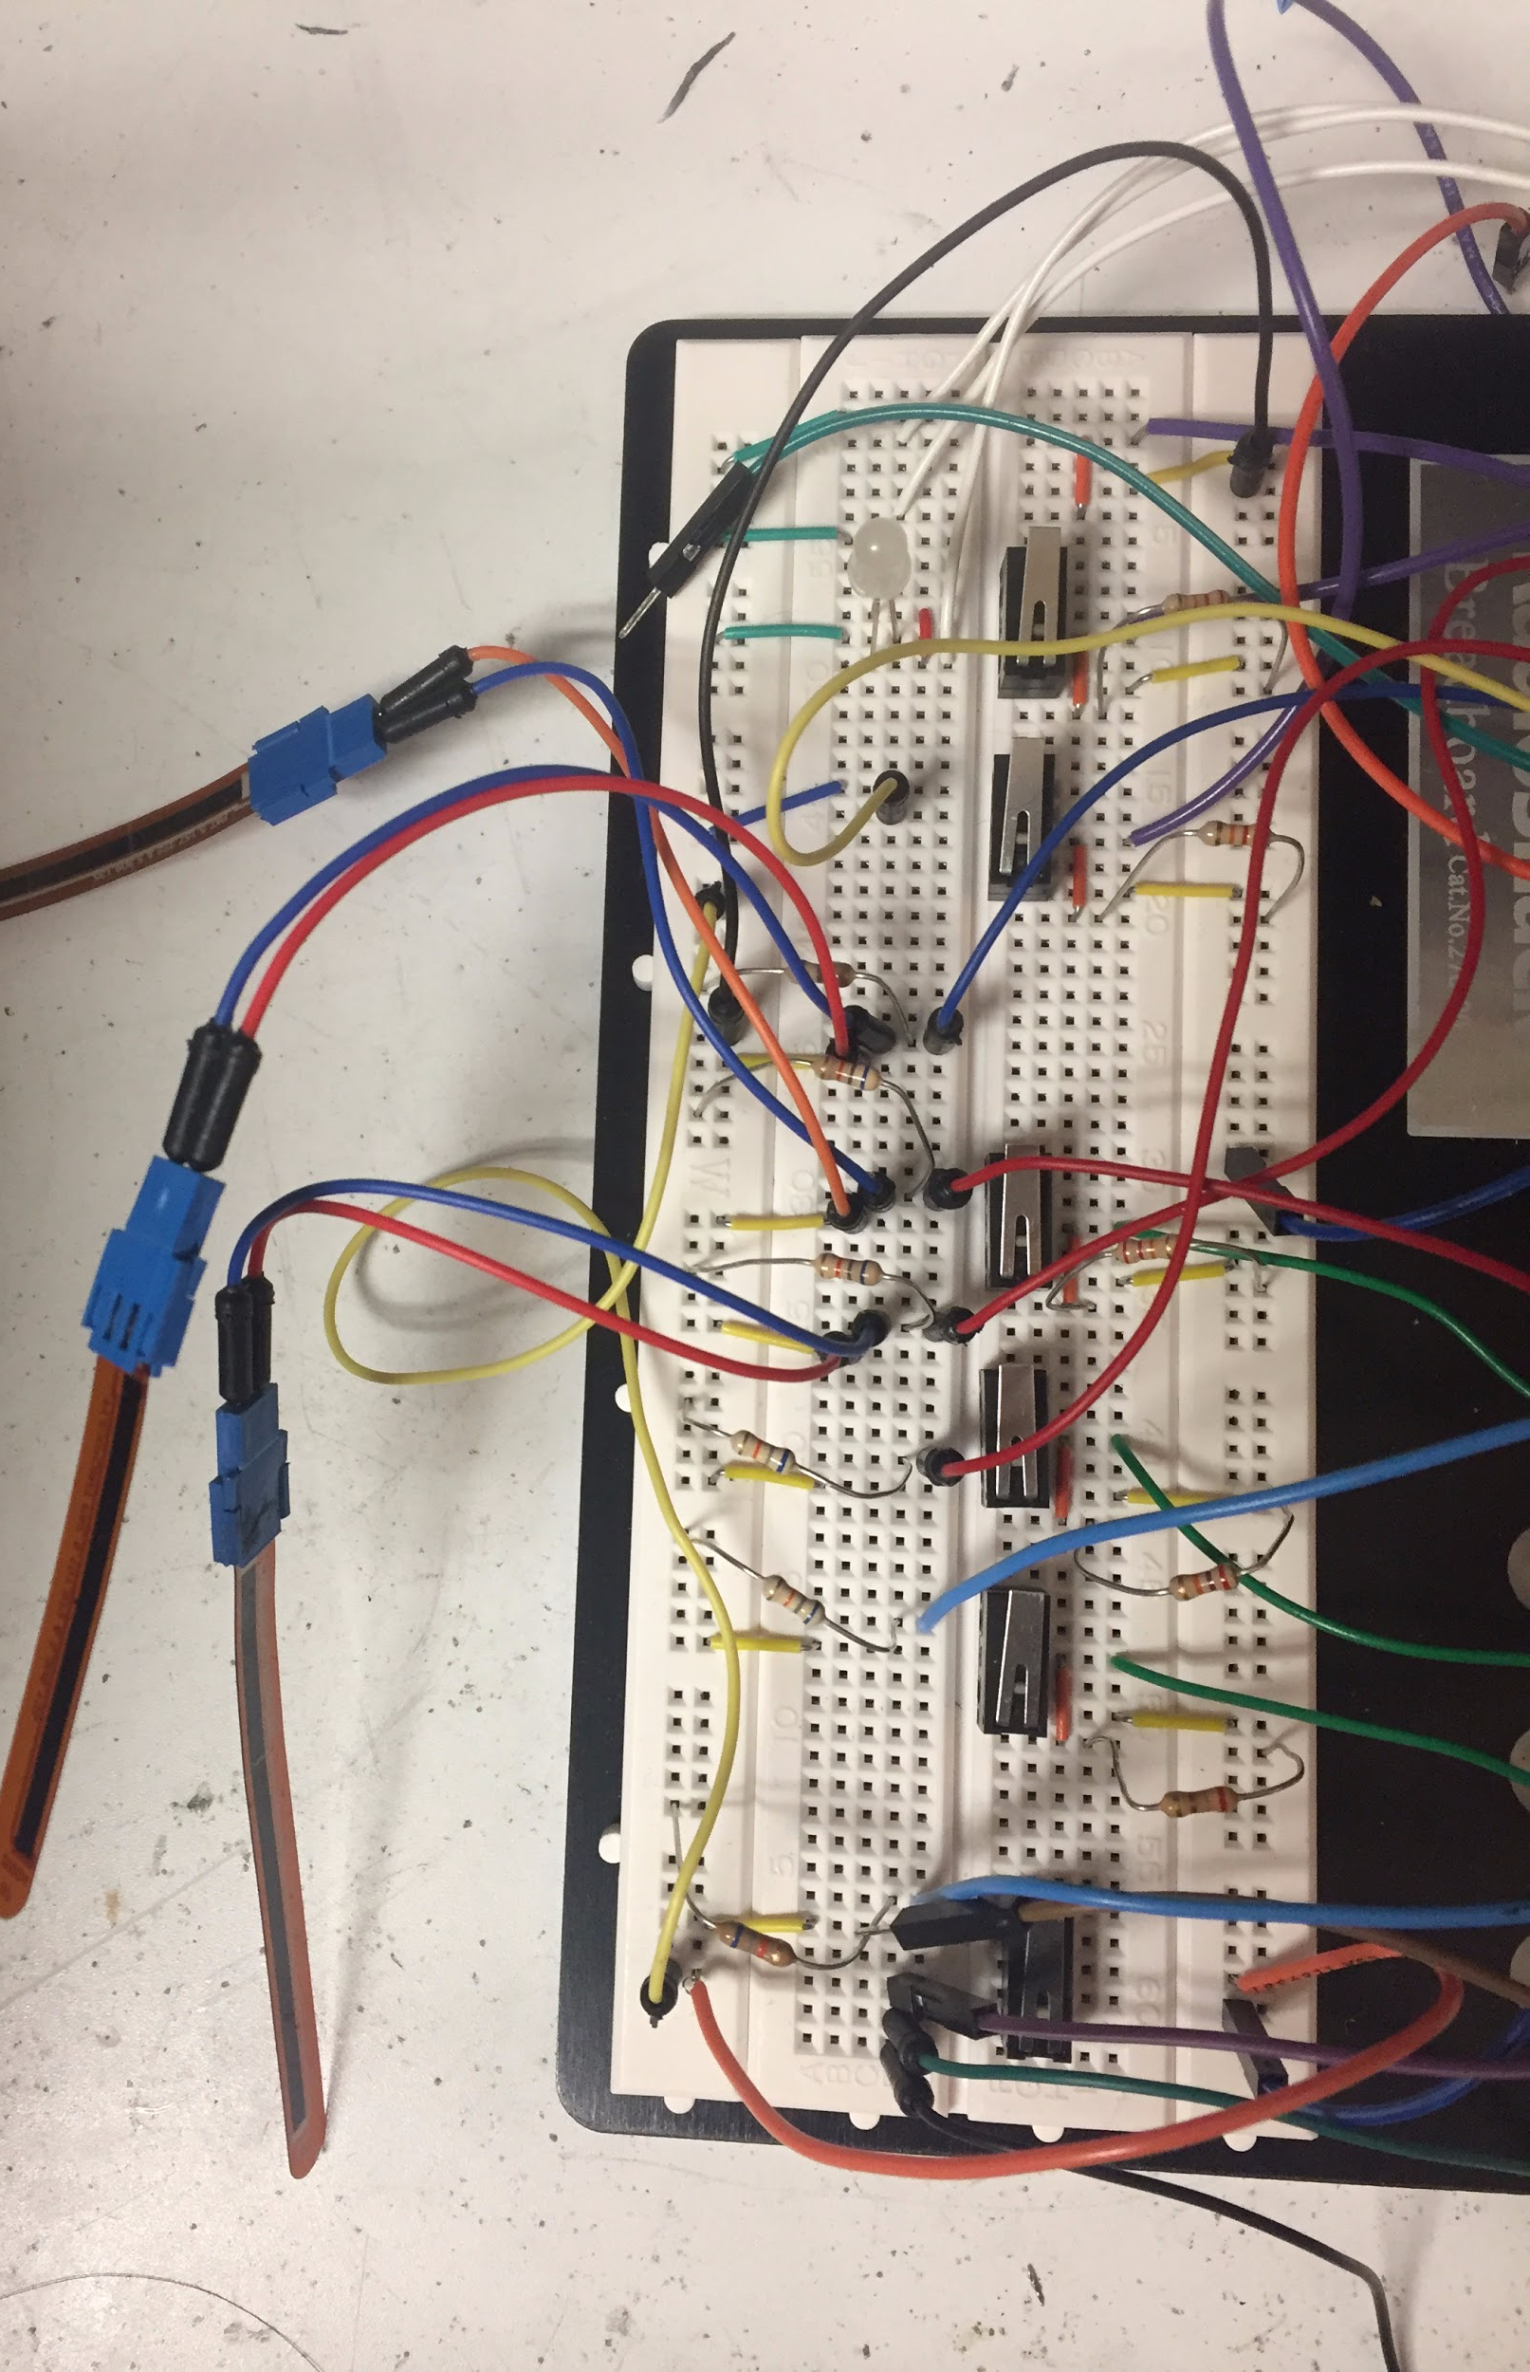
Circuit Board Assembly

Slide 32
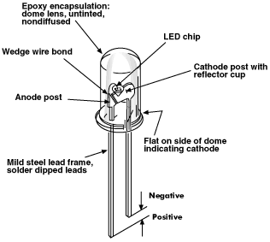
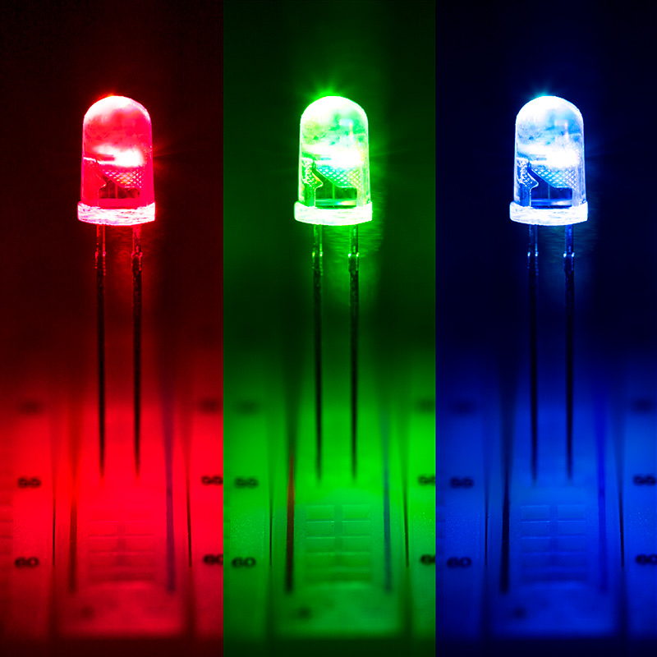
LED

Slide 33
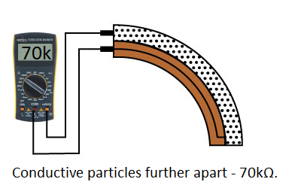
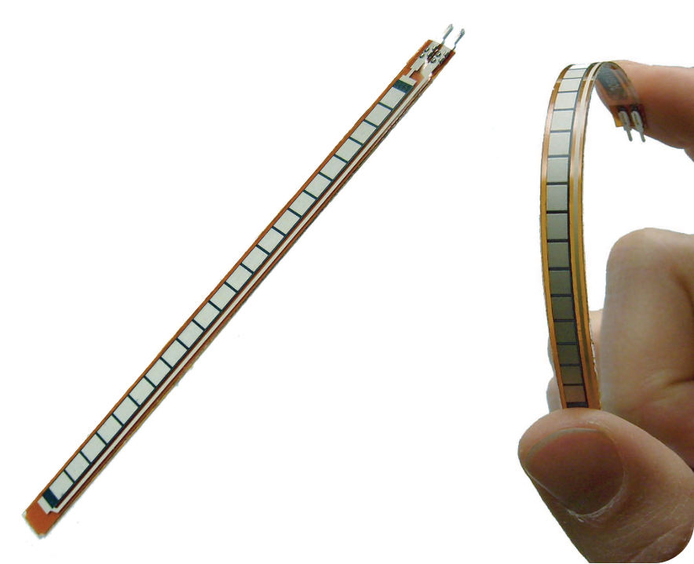
Flex Sensor

Slide 34
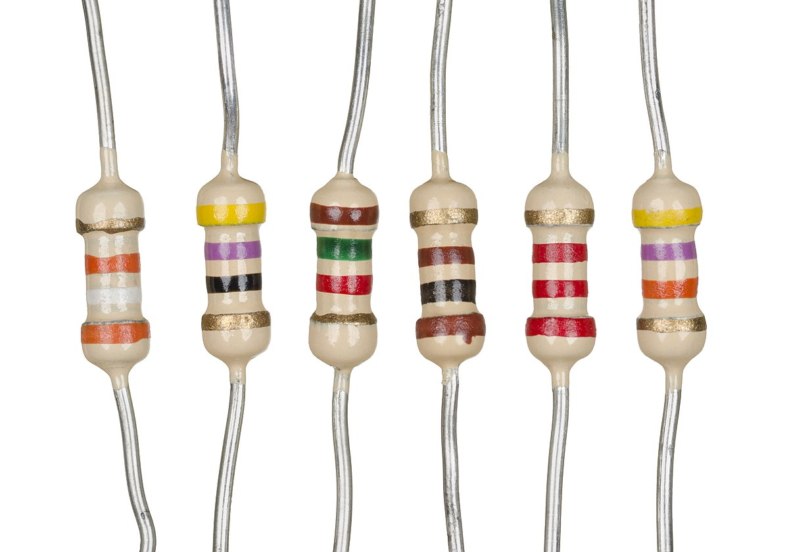
Resistors

Slide 35
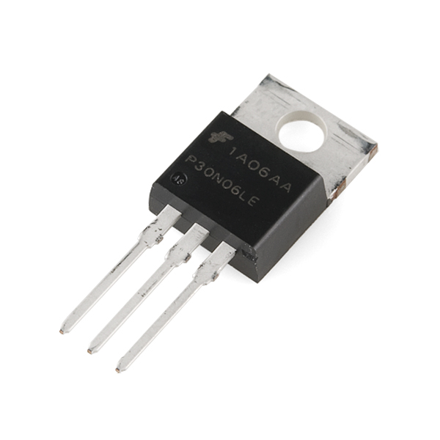
Mosfet

Slide 36
Connect with Computer
Notes:
USB Cable

Slide 37
Arduino Programming
Assembly and Testing

Slide 38
What is the Arduino/Teensy?

Slide 39
Hardware
microcontroller
small version of a basic computer
open-source electronics platform
able to read inputs - light on a sensor, a finger on a button, or a Twitter message - and turn it into an output

Slide 40
Software
C programming language w/Arduino layer

Slide 41
2. Structure

Slide 42
Basic Outline
The setup function will only run once
Loops consecutively, allowing your program to change and respond. Use it to actively control the Arduino board.
Notes:
Provide link to Arduino notebook (documentation)
Metaphor - getting dressed in the morning
Things you do after you get dressed

Slide 43
3. Programming

Slide 44
Variables
Designate place to store data
Initialize
Assign data
Notes:
Provide link to Arduino notebook (documentation)
Metaphor - getting dressed in the morning
Things you do after you get dressed

Slide 45
If Statements
Takes an expression in parenthesis and a statement or block of statements. If the expression is true then the statement or block of statements gets executed otherwise these statements are skipped.
Notes:
Provide link to Arduino notebook (documentation)
Metaphor - getting dressed in the morning
Things you do after you get dressed

Slide 46
If Statements
Notes:
Provide link to Arduino notebook (documentation)
Metaphor - getting dressed in the morning
Things you do after you get dressed

Slide 47
If Statements
Notes:
Provide link to Arduino notebook (documentation)
Metaphor - getting dressed in the morning
Things you do after you get dressed

Slide 48
Functions
Purposes:
Functions help the programmer stay organized. Often this helps to conceptualize the program.
Functions codify one action in one place so that the function only has to be thought about and debugged once.
Functions make the whole sketch smaller and more compact because sections of code are reused many times.
Notes:
Provide link to Arduino notebook (documentation)
Metaphor - getting dressed in the morning
Things you do after you get dressed
If statements: something happens, etc
Function is like if you wear different clothes for different activities
Outfits allow you to do different activities
If school uniform → go to school

